Slide 1

Machine Learning Based Road Accident Acknowledgement System
Batch No.:15
Aditya Pandey(18P31A0501)
Gaurav Kumar(18P31A0521)
Viswajit Singh(18P31A0558)
Guide :- Mrs. J. Divya Lalitha Sri.

Slide 2
ABSTRACT
Here we are proposing the real time application which is useful for the government as well as for the travellers.
We are going to use this application to avoid and tackle accidents.
Our proposed system describes one possibilities of how to use collected data about traffic accidents to mine frequent patterns and important factors causing different types of accidents and predict the accident .
Here we provide two Sub-System, one for a user and another for traffic police(Admin).
Users can have access to data, which is represented over a map . In the map, a pin drop represents the sign of probability of an accident over their destinated road. The same goes for another sub-system which is handled by the police and they maintain the database. Using the data , they can be more active at a particular time.

Slide 3
REQUIREMENTS
Hardware –
System – Currently lowest version of desktop/laptop
Hard Disk – 40 GB
Ram – 1 GB
Software –
Operating System – Window 8 or above
Front-End – HTML, CSS, JAVASCRIPT
Framework – BOOTSTRAP, FLASK
Back-End – Python
API – Google Map, DarkSky (Weather data)

Slide 4
ANALYSIS
In this analysis we going to cover three major topic
Novelty in the Proposed system
Block diagram of Proposed system
Features extracting from dataset
NOVELTY IN THE PROPOSED SYSTEM
In our proposed system which states as follow – our system describes one possibilities of how to use collected data about traffic accidents to mine frequent patterns and important factors causing different types of accidents and predicting the accident .
As mentioned in above statement, a user can easily predict accident in his/her journey between source and destination. Which make them aware and they can travel with more precaution.
On other hand authority have full access over data and act accordingly. Even they can act before any accident on particular day and may be pre prepared for any kind of tragedy.

Slide 5
ANALYSIS
BLOCK DIAGRAM OF PROPOSED SYSTEM
UPLOAD FILE
HOME
VIEW DATASET
DATASET
API GOOGLE MAP(MARKER)
LOGIN
UPLOAD DATA
EXPLORATION
API GOOGLE MAP
INTERACTION
PREDICTION MODEL
API WEATHER DATA
LOG OUT
ADMIN

Slide 6
ANALYSIS
USER
HOME
API GOOGLE MAP
INTERACTION
PREDICTION MODEL
API WEATHER DATA
USER

Slide 7
ANALYSIS
FEATURES EXTRACTING FROM DATASET
We have take dataset from Kaggle website. In which A comprehensive dataset of RTAs in the UK from 2012-2014 (discontinuous) is taken. These data collected and hosted by UK Dept of Transport.
Key Features extracted from dataset are : -
location: latitude/longitude coordinates
Week day, hour of day, day of year, year.
Road condition, speed limit, road number.
Cluster, local authority.
Weather data

Slide 8
MODULES IDENTIFIED IN PROPOSED SYSTEM
In our proposed system, we have divided our modules in two part
Admin
User
ADMIN
Admin Login – Admin have full authority over the system to upload, view and analysis dataset. Admin can control and take precaution by taking proper action before or after accident.
Dataset – This section is used to upload and view dataset. In this admin can upload data as a CSV file or a single data at a time.
Exploration – This section is for the analysis purpose over uploaded data.
Interaction – This is the section where the system predict accident. This section help authority to action before any bad happen.
Log out and Home – Log out allow admin to log out after their work is done and home is something which introduce about system to admin.

Slide 9
MODULES IDENTIFIED IN PROPOSED SYSTEM
In our proposed system, we have divided our modules in two part
Admin
User
USER
Home– User can access prediction page from home page.
Interaction – This is the section all magic happen. Predicting road accident between source and destination make sure that user/travellers pay full attention and take full precaution.

Slide 10
ALGORITHM
Random Forest
Read dataset through pandas
Dataset already pre-processed ,so no need of data preprocessed.
Split dataset into two part i.e. training set and test set. We had taken 70% data for training and 30% data for testing.
Now we are implementing RandomForestClassifier method to implement Random Forest with parameter n_estimators =100.
n_estimators =100 means 100 numbers of trees will build before taking the maximum voting or averages of predictions. Higher number of trees give better performance but makes code slower.
Now we are using fit methods for training and predict methods for testing the algorithm .

Slide 11
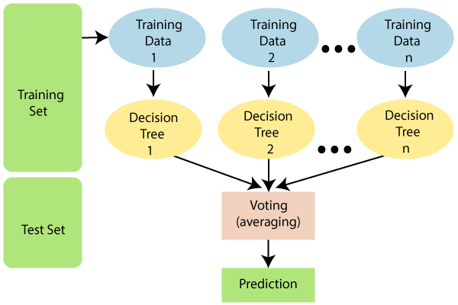
ALGORITHM

Slide 12
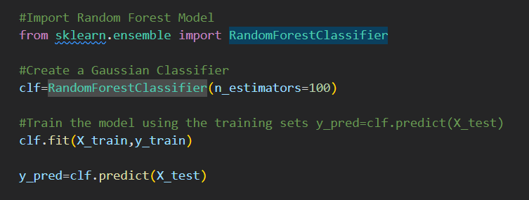
ALGORITHM

Slide 13
SYSTEM DESIGN (UML diagrams)
UML – stand for Unified Modeling Language, is a general purpose, developmental, modeling language in the field of software engineering that is intended to provide a standard way to visualize the design of a System.
UML diagram we are using: -
Activity diagram
Use Case diagram
Sequence diagram
Collaboration diagram
Class diagram

Slide 14
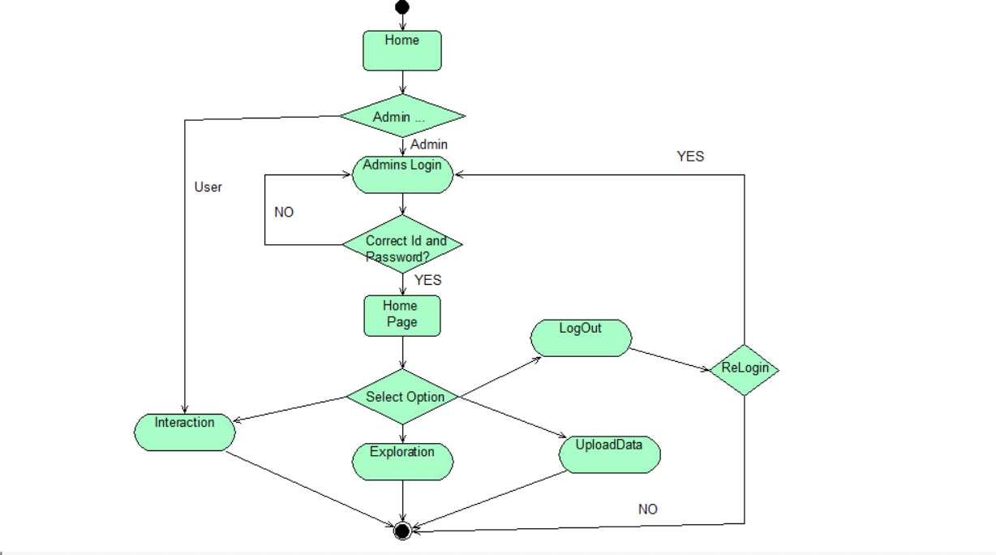
Activity Diagram

Slide 15
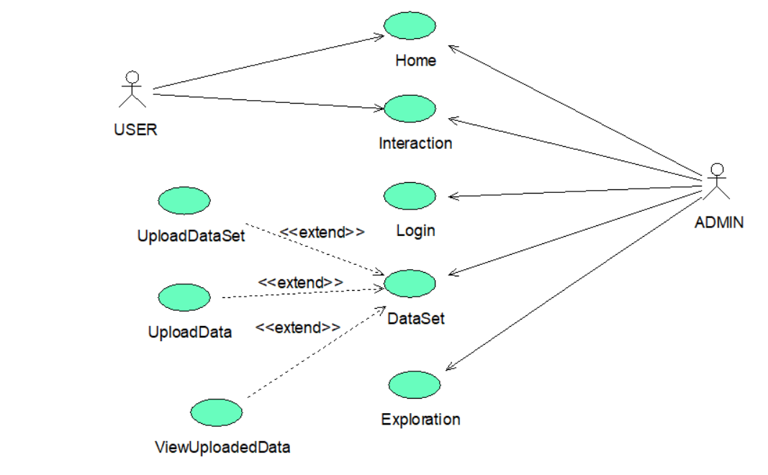
Use-Case Diagram

Slide 16
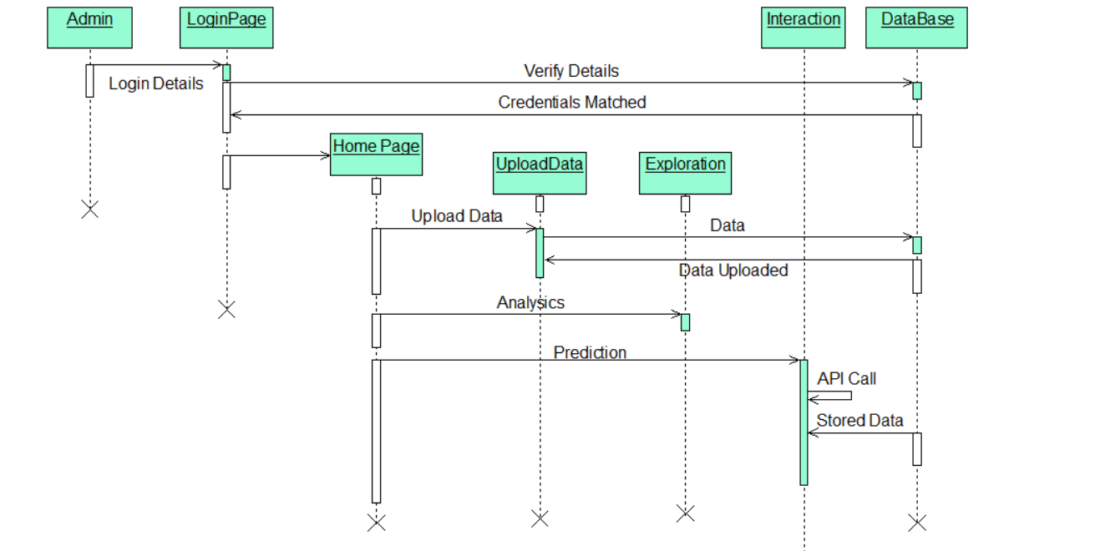
Sequence Diagram

Slide 17
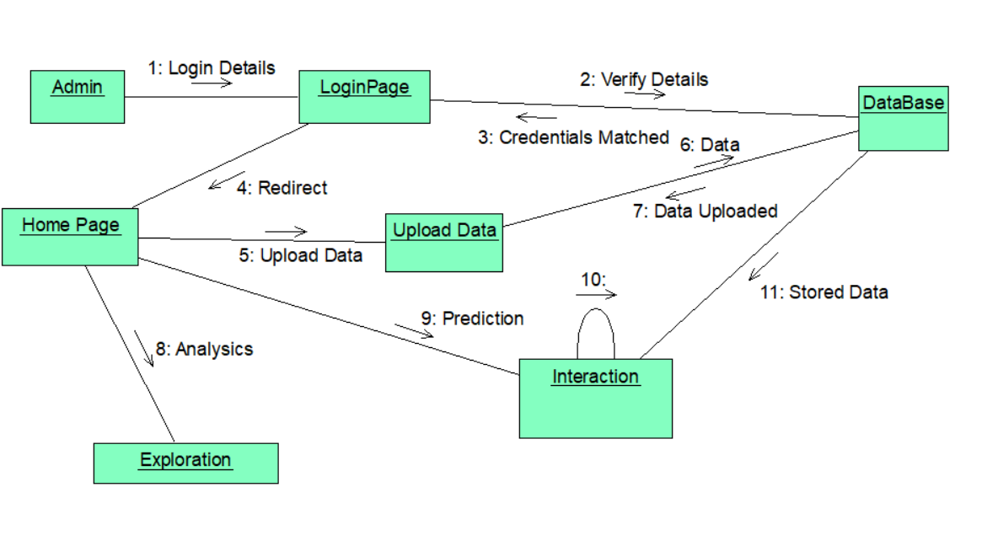
Collaboration Diagram

Slide 18
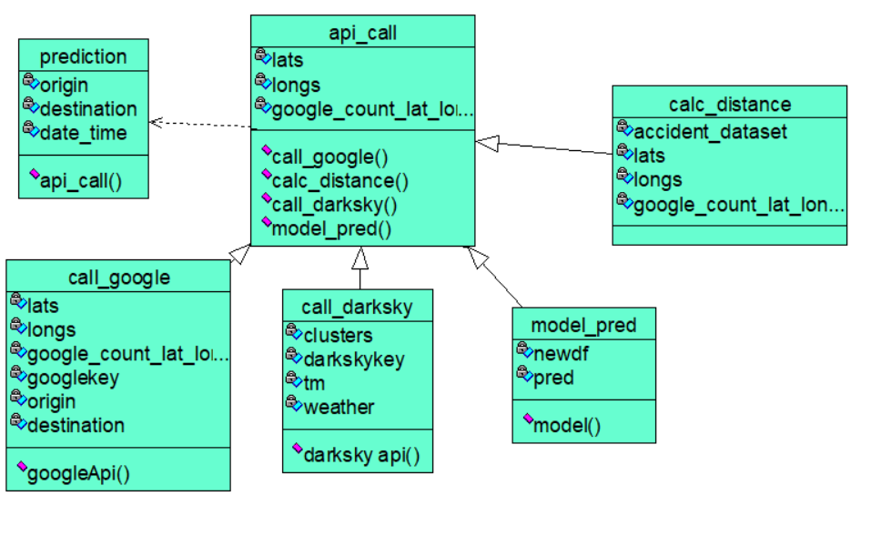
Class Diagram

Slide 19
TEST CASE IDENTIFICATION
The purpose of testing is to discover errors. Testing is the process of trying to discover every conceivable fault or weakness in a work product. It provides a way to check the functionality of components, sub assemblies, assemblies and/or a finished product It is the process of exercising software with the intent of ensuring that the Software system meets its requirements and user expectations and does not fail in an unacceptable manner.
Here we going to perform test case identification on following list: -
Login page
Dataset Page
Logout page
Interaction Page

Slide 21
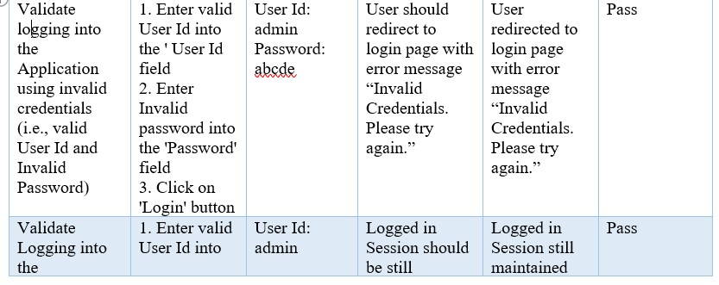
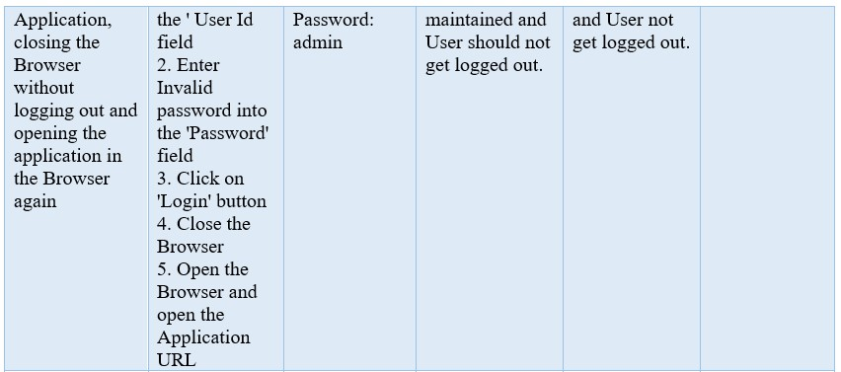

Slide 22
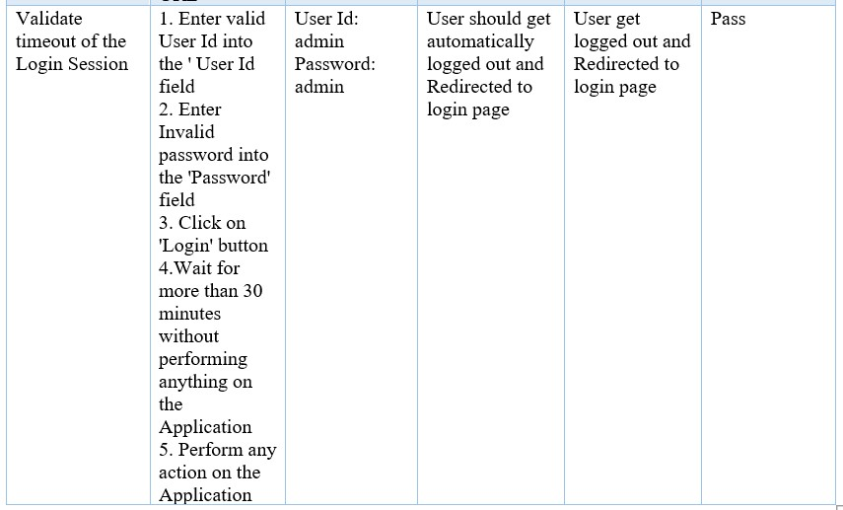

Slide 23
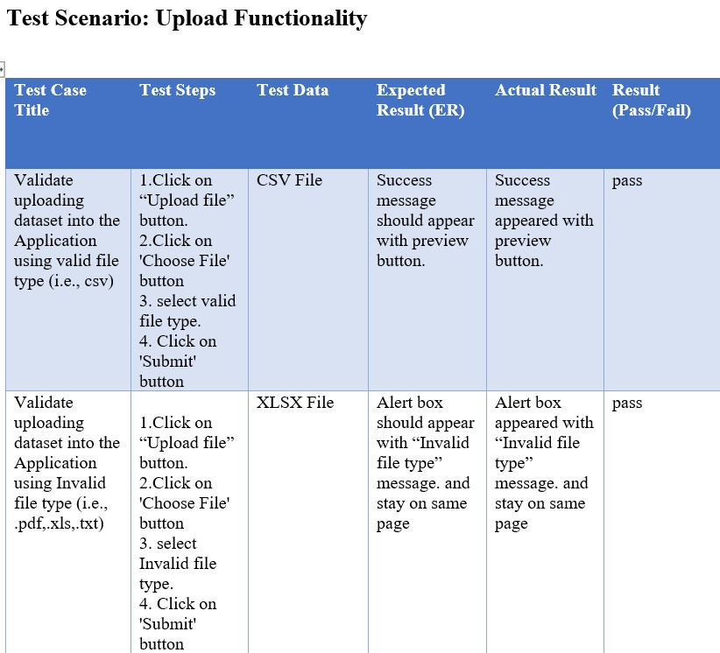

Slide 24
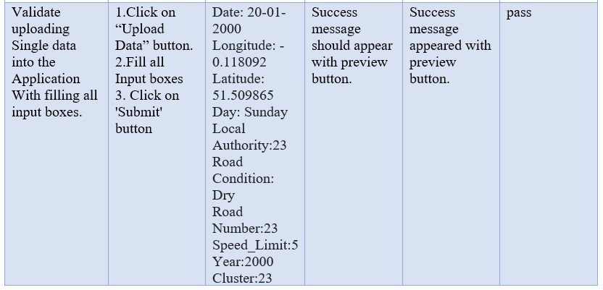
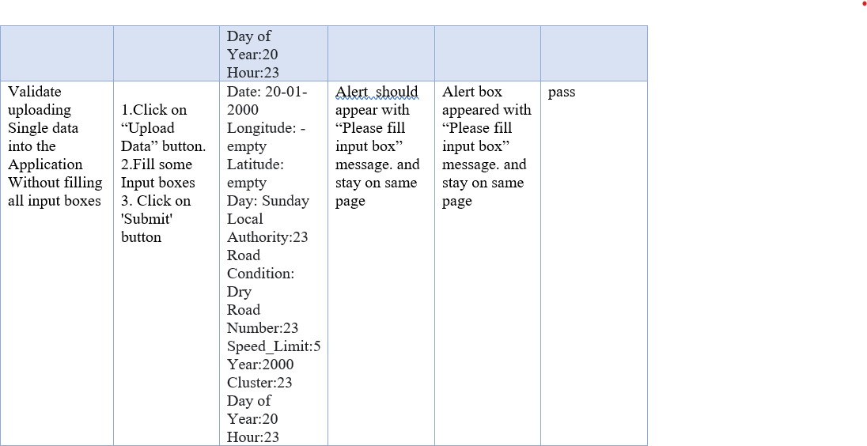

Slide 25
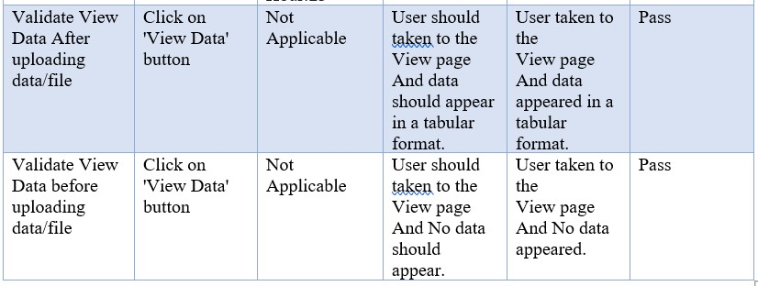

Slide 26
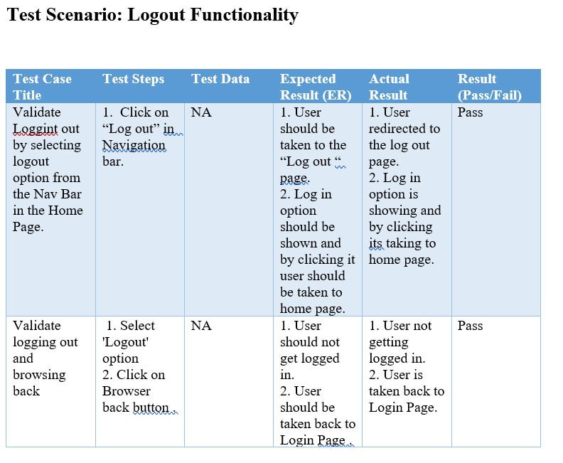

Slide 27
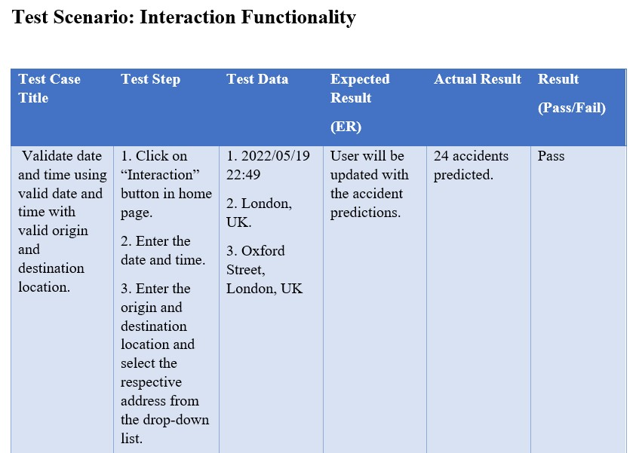

Slide 28
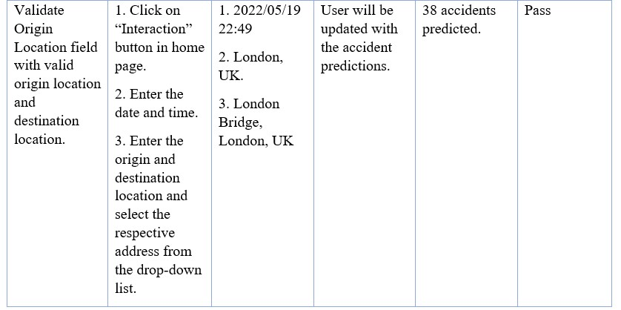
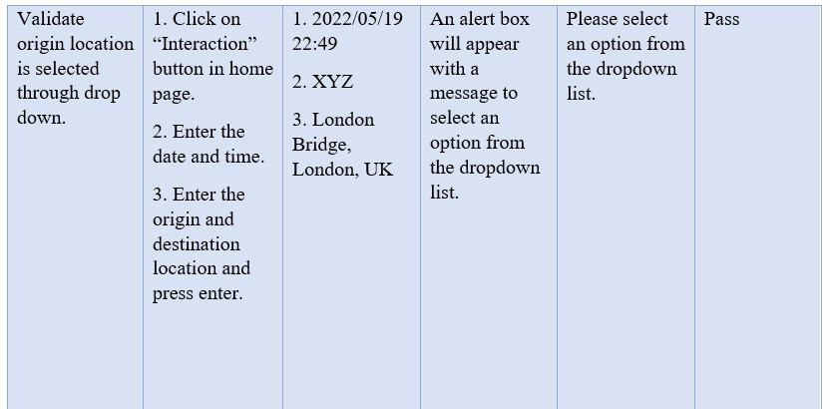

Slide 29
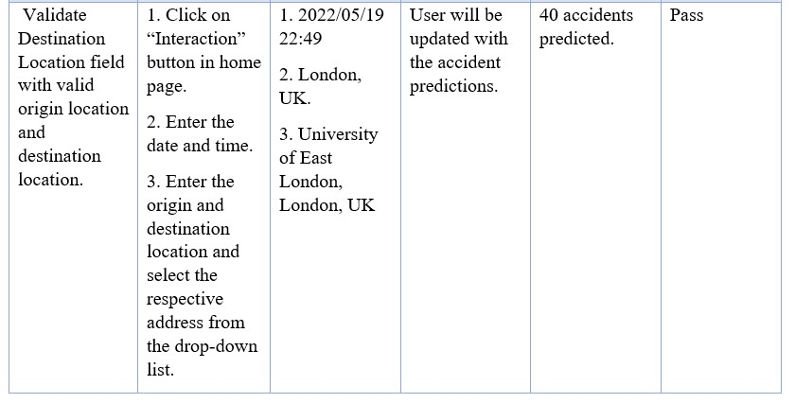
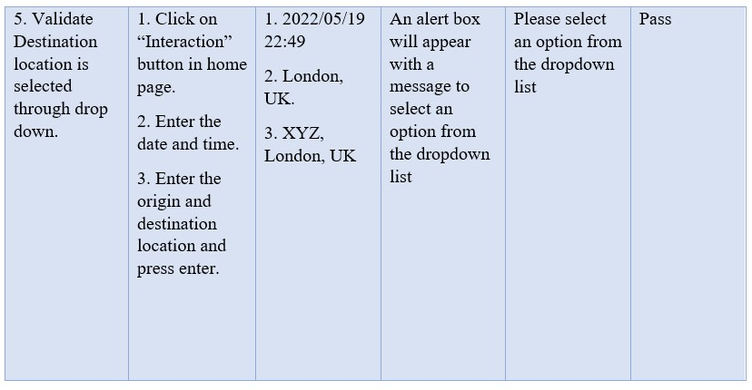

Slide 30
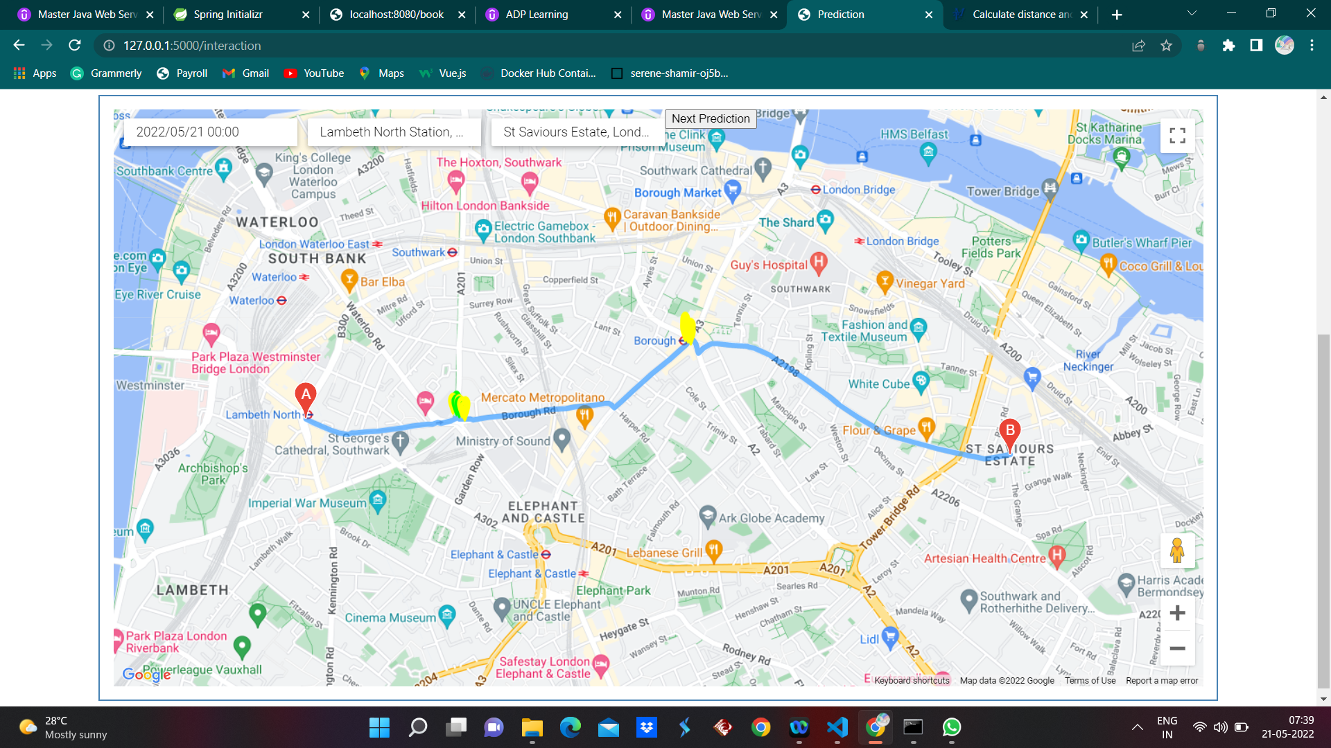
OUTPUT SCREEN SHOTS OF THE PROJECT EXECUTION
Figure: Prediction at 00:00AM from Lambeth North Station to St. Saviours Estate,London

Slide 31
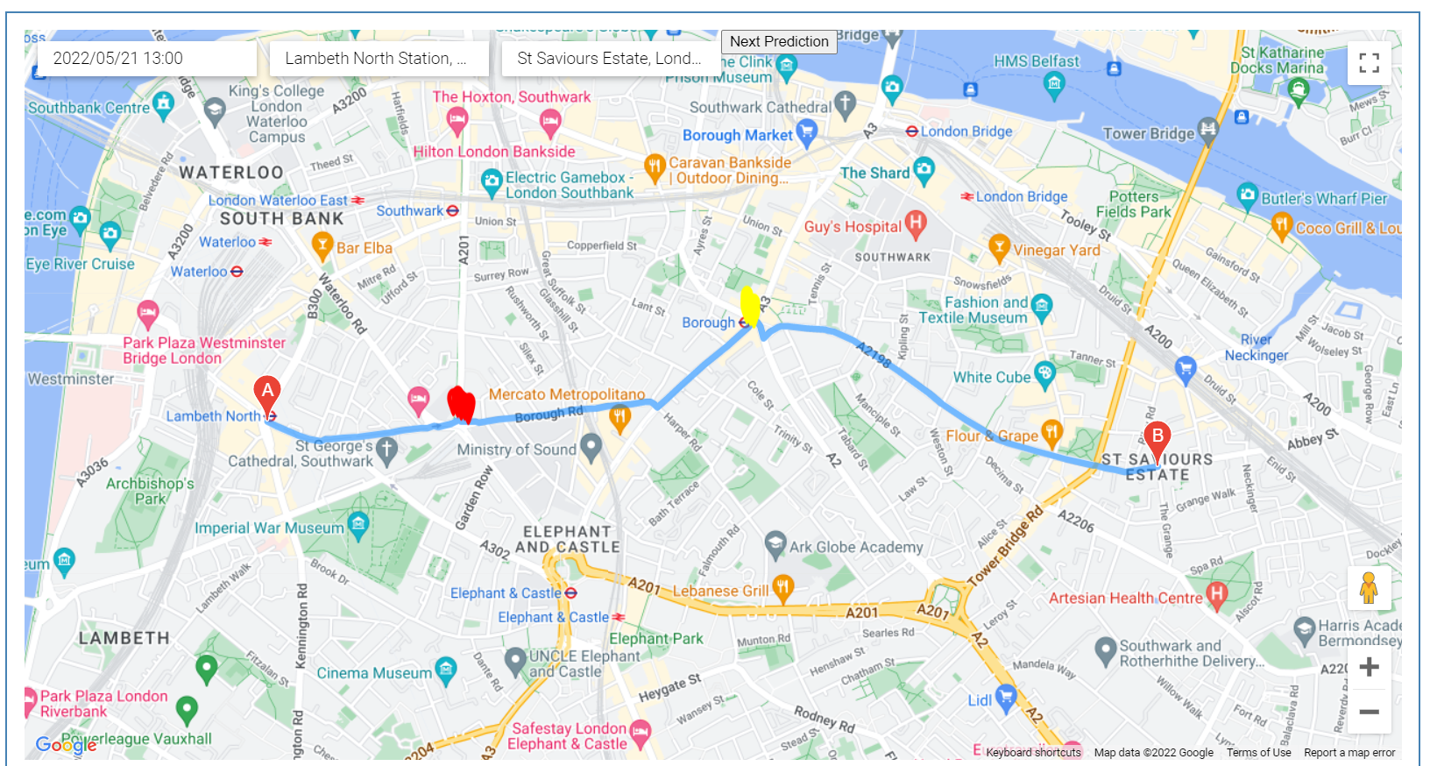
Figure: Prediction at 01:00PM from Lambeth North Station to St. Saviours Estate,London

Slide 32

Figure: Prediction at 06:00PM from Lambeth North Station to St. Saviours Estate,London

Slide 33
CONCLUSION
Our proposed system provide an precaution to an user for their safe journey between source and destination.
In this proposed system, three different color used in the map to show accident zone.
Authority/Admin can always be in “READY STATE” for any kind of accident. They even can control these accident with the data.
The scope of this proposed system is very high in the future, because this proposed system not only help in prediction but also in the analysis.
For real time based system, it can be more effective with google map, and other useful API.

Slide 34
REFERENCE
https://www.javatpoint.com/machine-learning-random-forest-algorithm
https://stackoverflow.com/
https://developers.google.com/apis-explorer
https://www.kaggle.com/daveianhickey/2000-16-traffic-flow-england-scotland-wales/version/8
https://darksky.net/dev
https://flask.palletsprojects.com/en/2.1.x/
https://mode.com/python-tutorial/libraries/pandas/#:~:text=Pandas%20is%20a%20Python%20library,extremely%20active%20community%20of%20contributors.

